Slide 1
UCSD Embedded RTOS Final Assignment
By
Hsuankai Chang
hsuankac@umich.edu

Slide 2
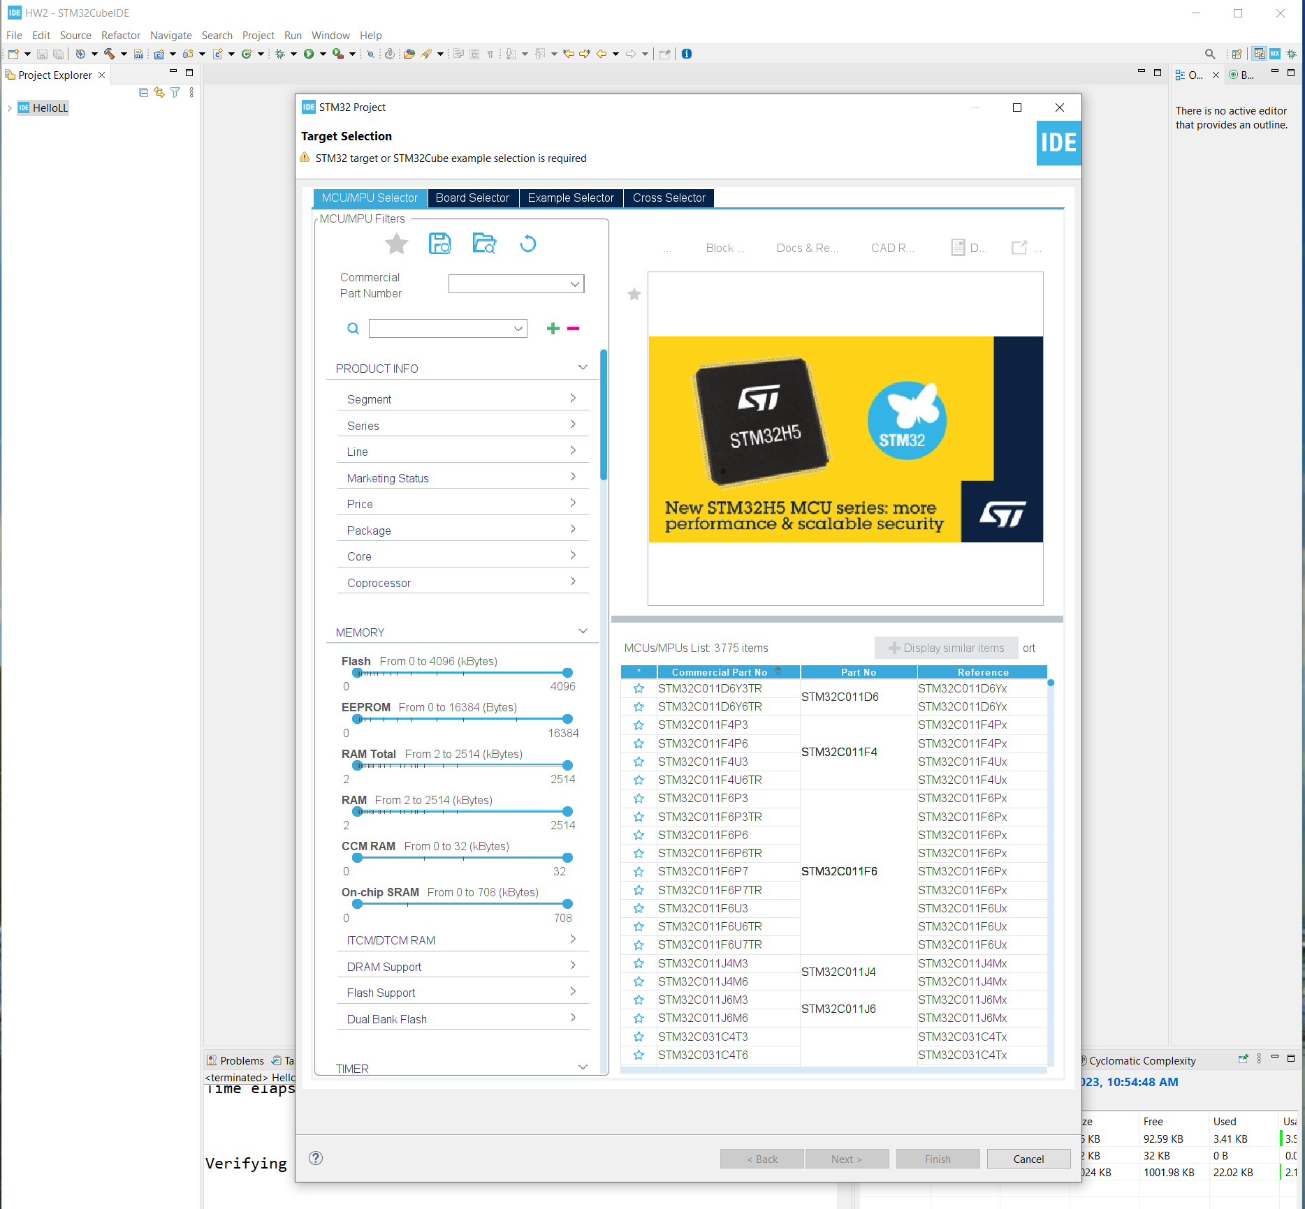
Step 1. Startup STM32CubeIDE and create new STM32 project

Slide 3
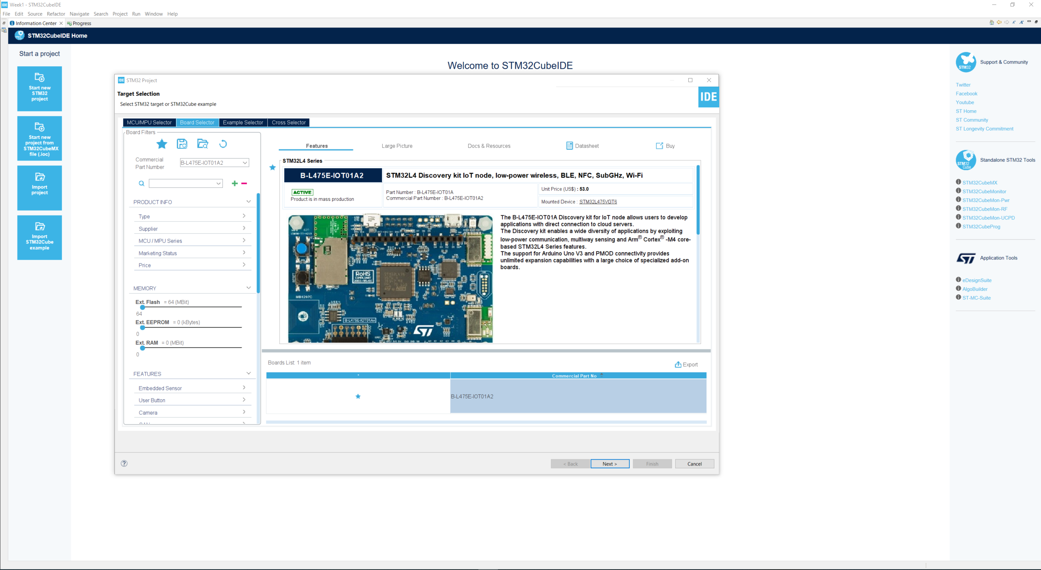
Step 2. Access board selector and type in the board you use, click Next

Slide 4
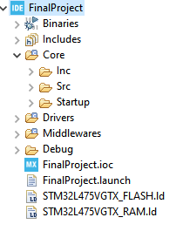
Step 3. Enter the project name then click Next

Slide 5
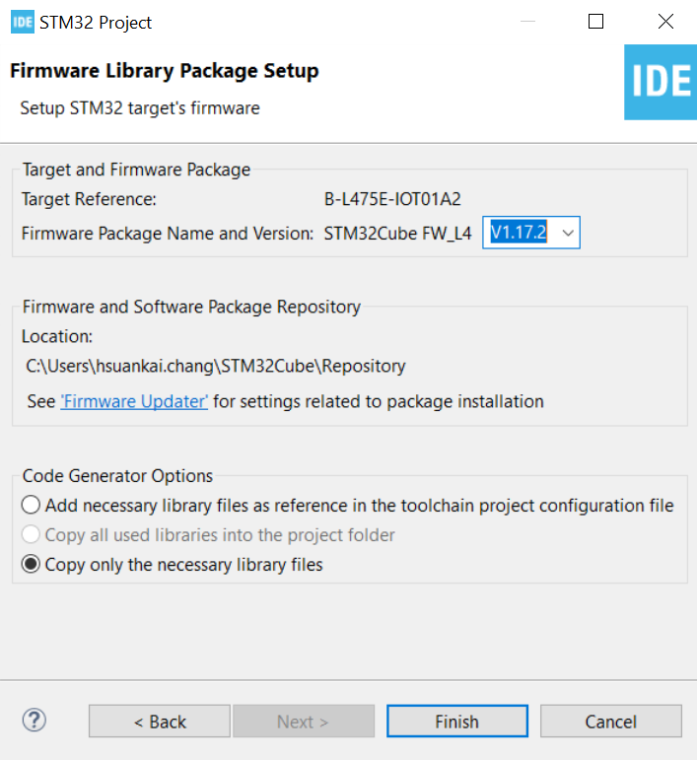
Step 4. See the firmware package name and version

Slide 6
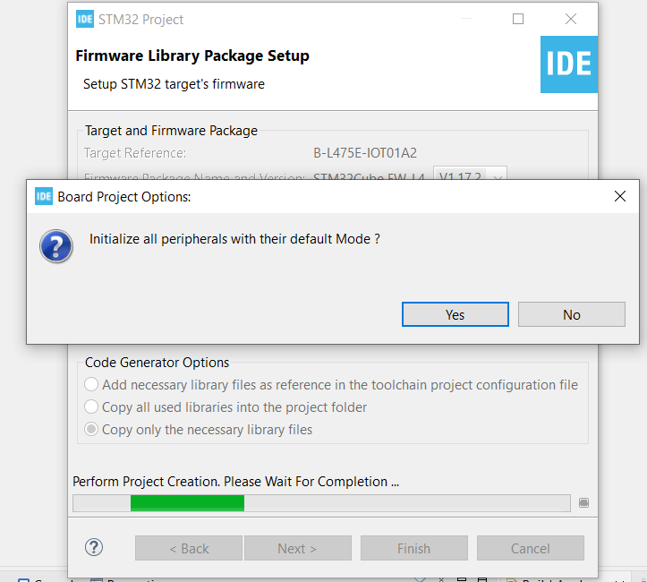
Step 5. Click yes to initialize all peripherals to default

Slide 7
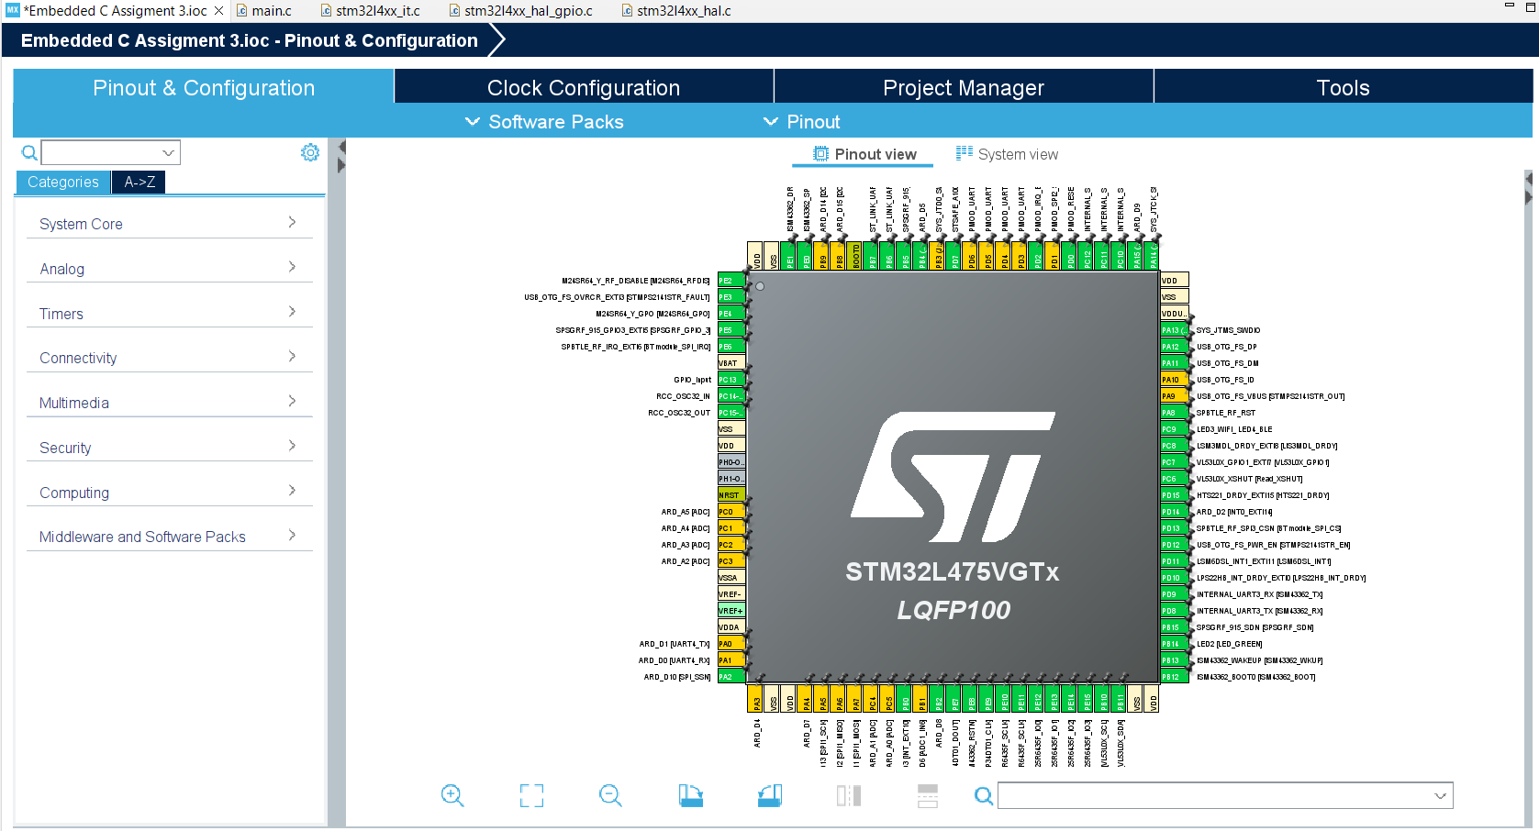
Step 6. When in .ioc file, click Pinout & Configurations.

Slide 8
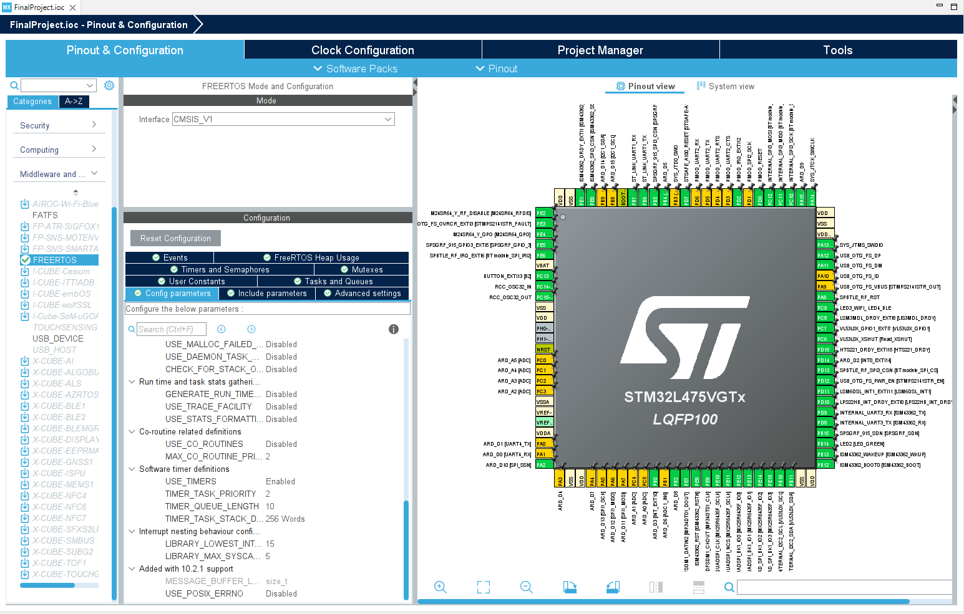
Step 7. I pick option 1 as my final project, and will demonstrate required features 1 – 4 in my following slides. Enable CMSIS_V1 FreeRTOS, and enable software timers in the config parameters.

Slide 9
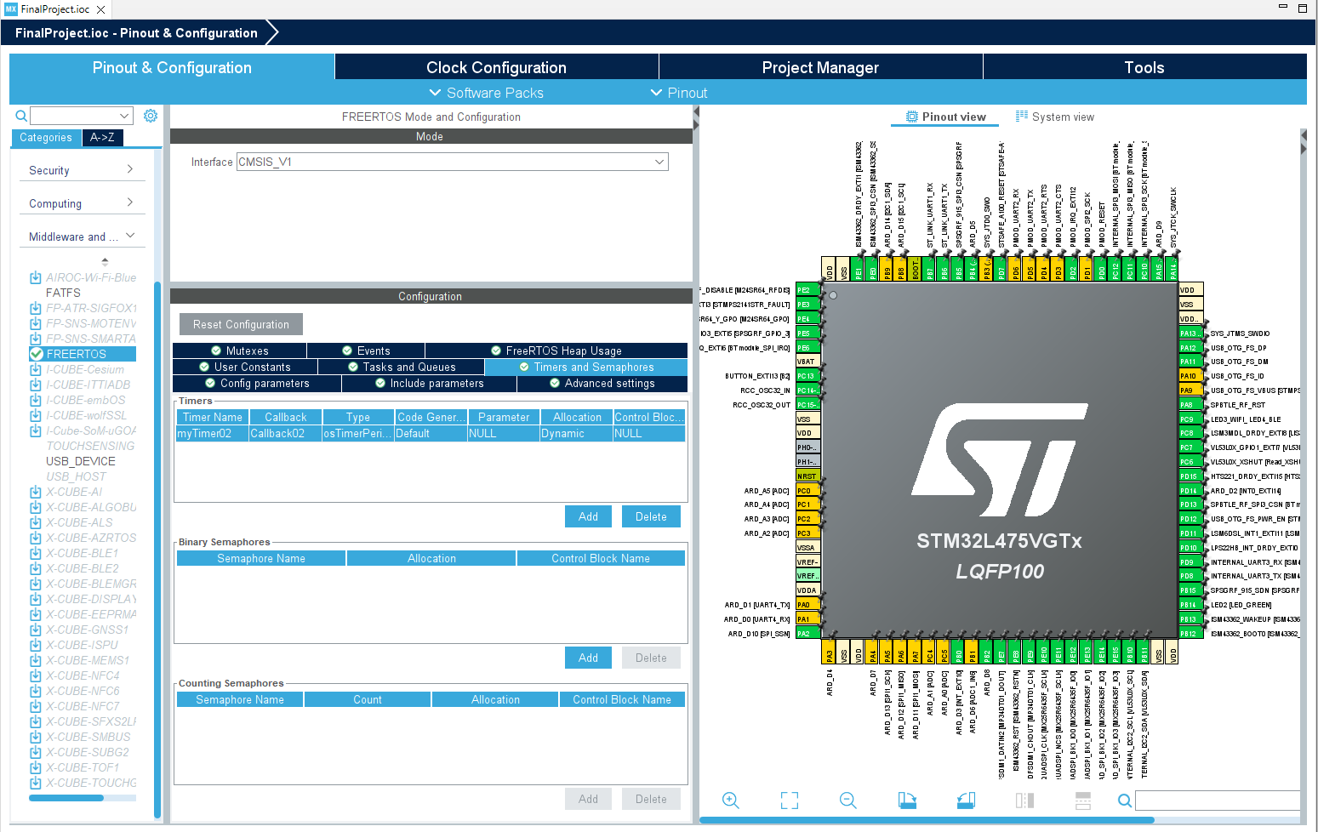
Step 8. Add one periodic timer task, for one shot timer, I manually create it using FreeRTOS API

Slide 10
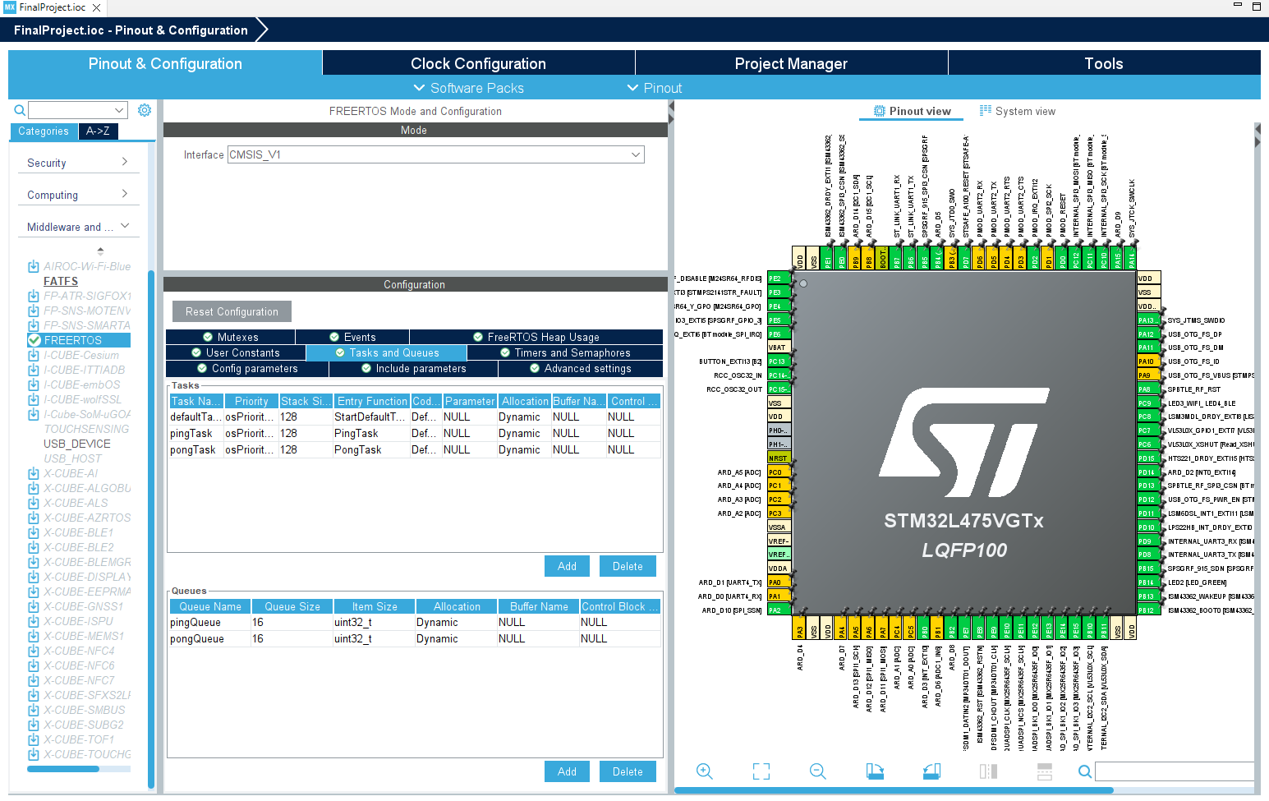
Step 9. Besides default task, add two more tasks, one ping task and one pong task for feature 4

Slide 11
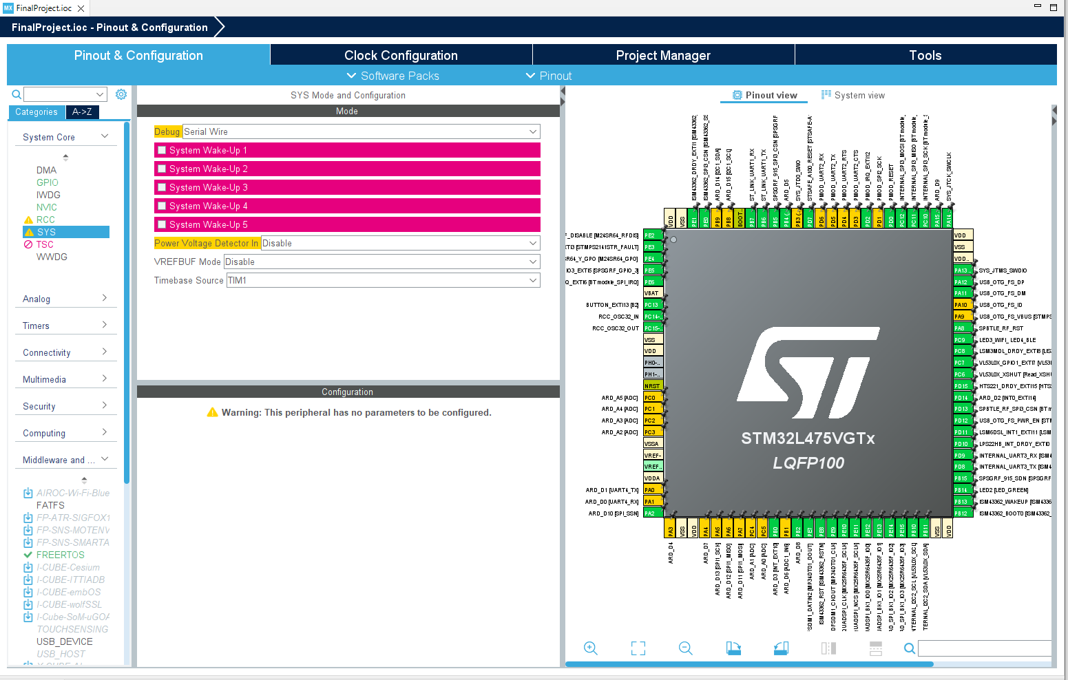
Step 10. Change Timebase source to use TIM1

Slide 12
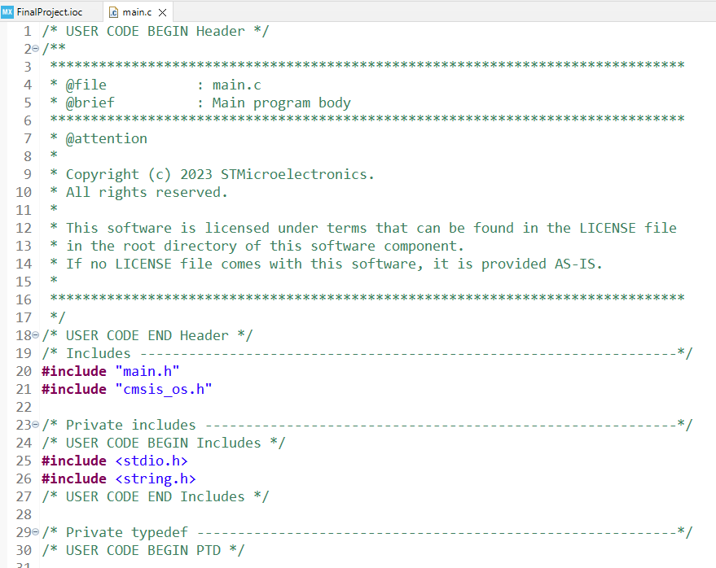
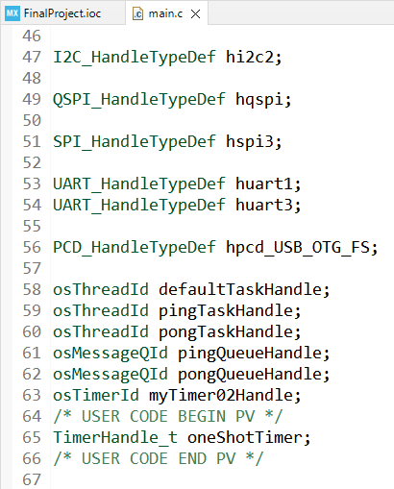
Step 11. Code the main.c file, include more header files and TimerHandle_t variable for one shot timer

Slide 13
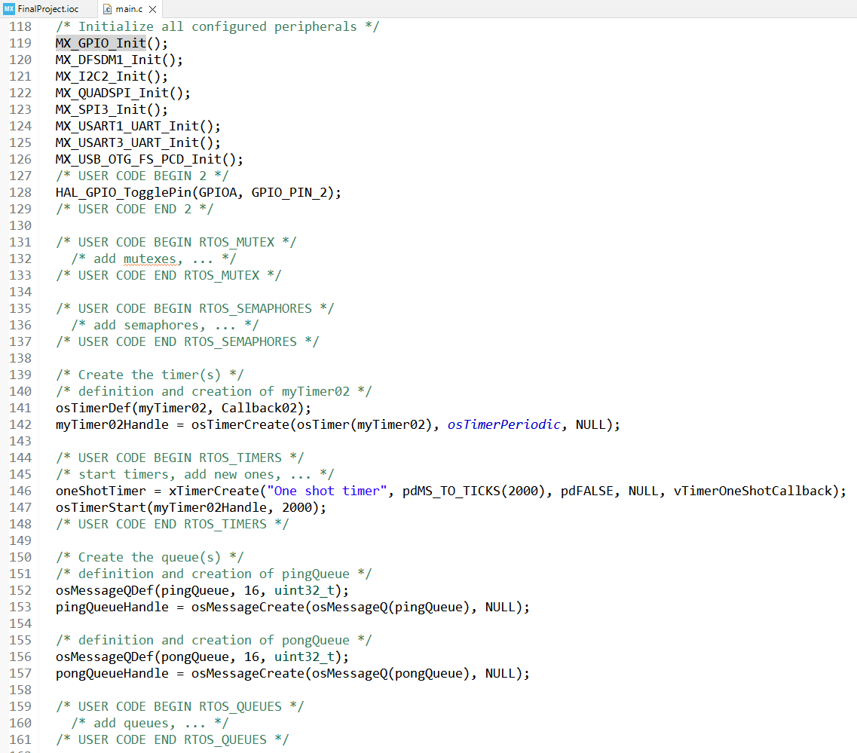
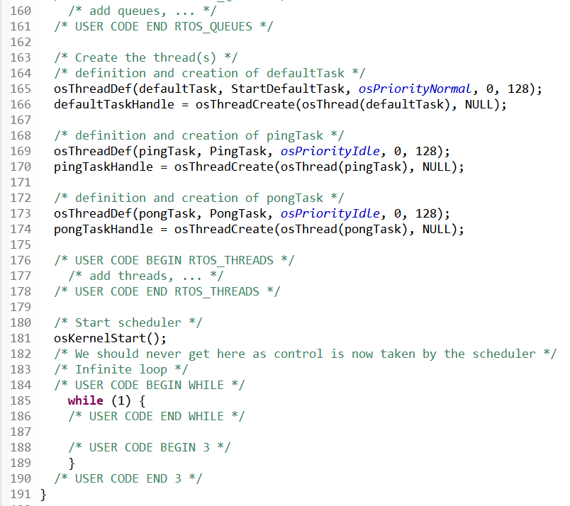
Step 12. Timer, task and queue creation

Slide 14
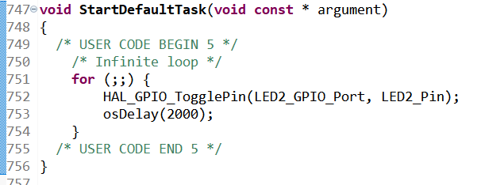
Step 13. Feature 1, flashing LED2

Slide 15
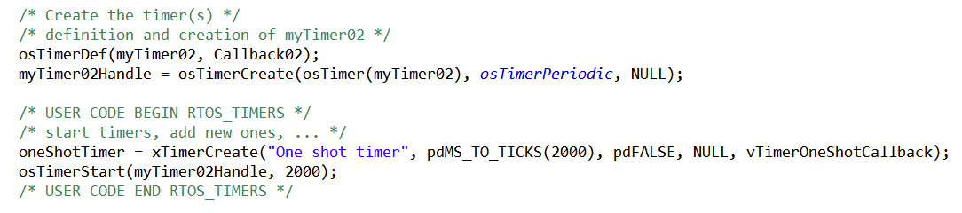
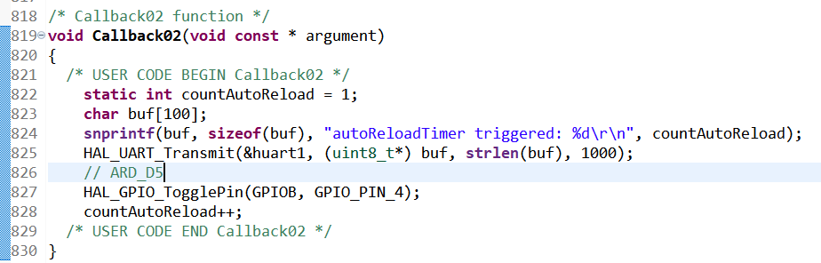
Step 14. Feature 2, periodic timer and one-shot timer creation, periodic timer start, and periodic timer callback function

Slide 16
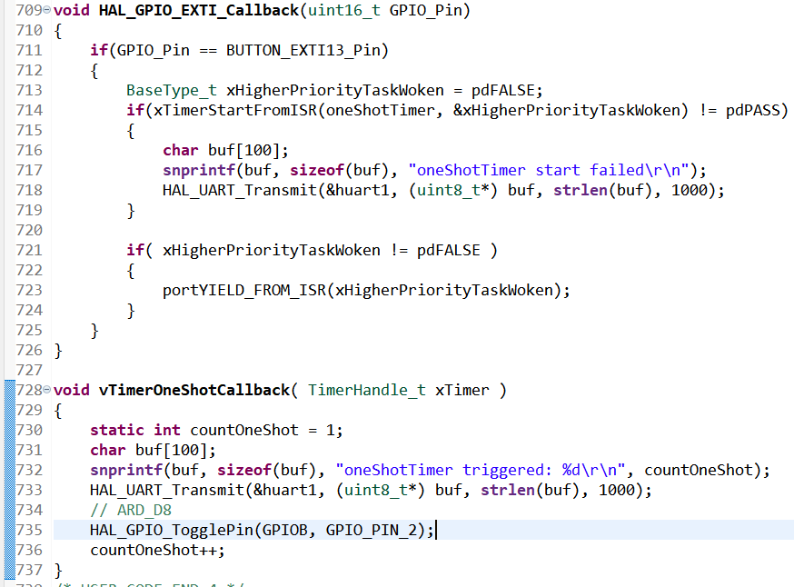
Step 15. Feature 3, one shot timer code. The reason why I did not use CMSIS API to create one shot timer is, I find out osTimerStart can not be used in ISR, so change to use FreeRTOS API

Slide 17
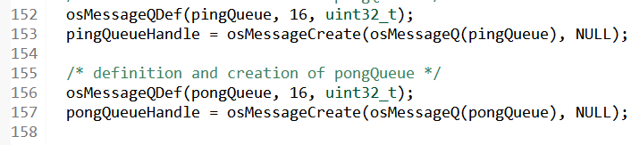
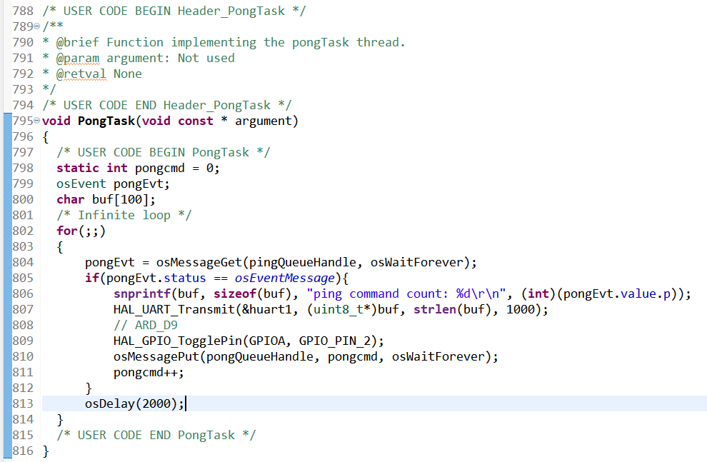
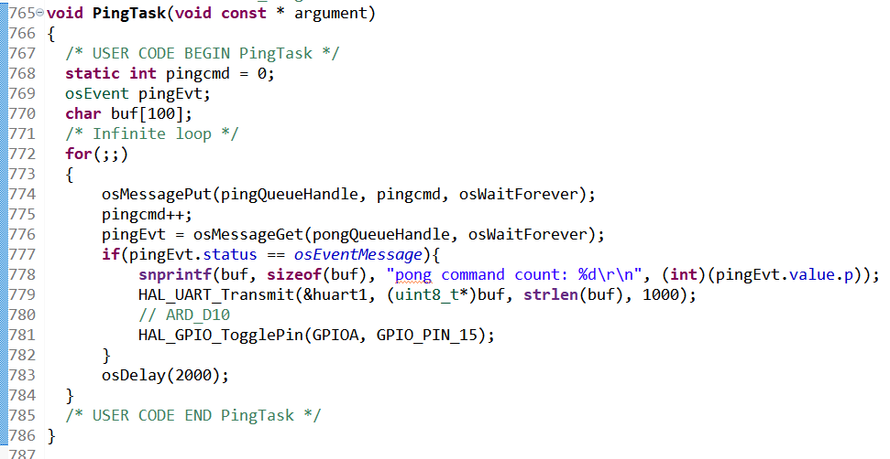
Step 15. Feature 4, ping pong task

Slide 18
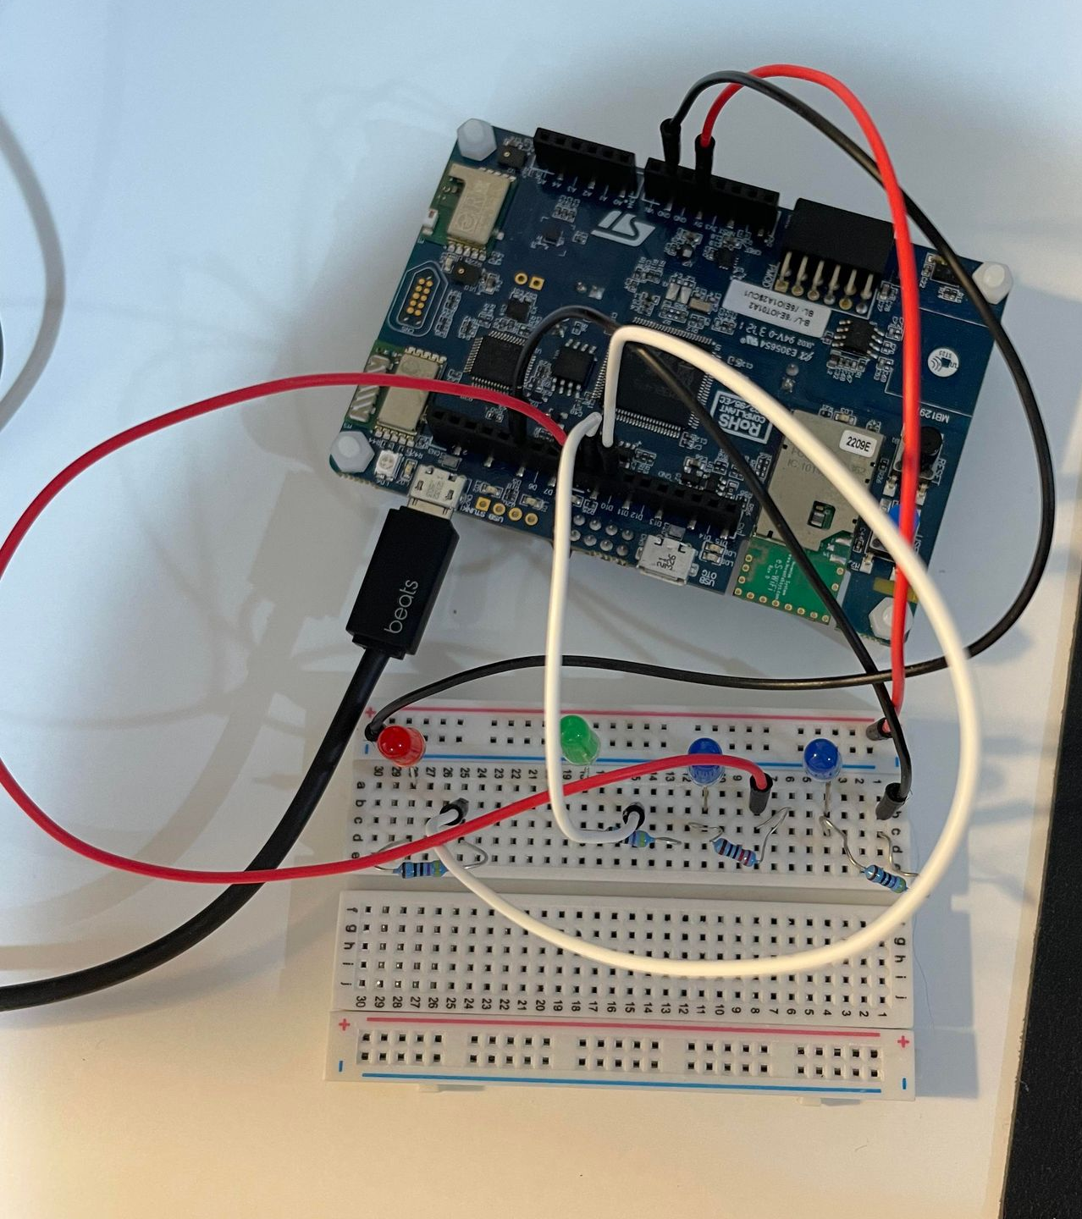
Step 16. Connect the hardware, from right to left is ARD_D5, ARD_D8, ARD_D9, ARD_D10

Slide 19
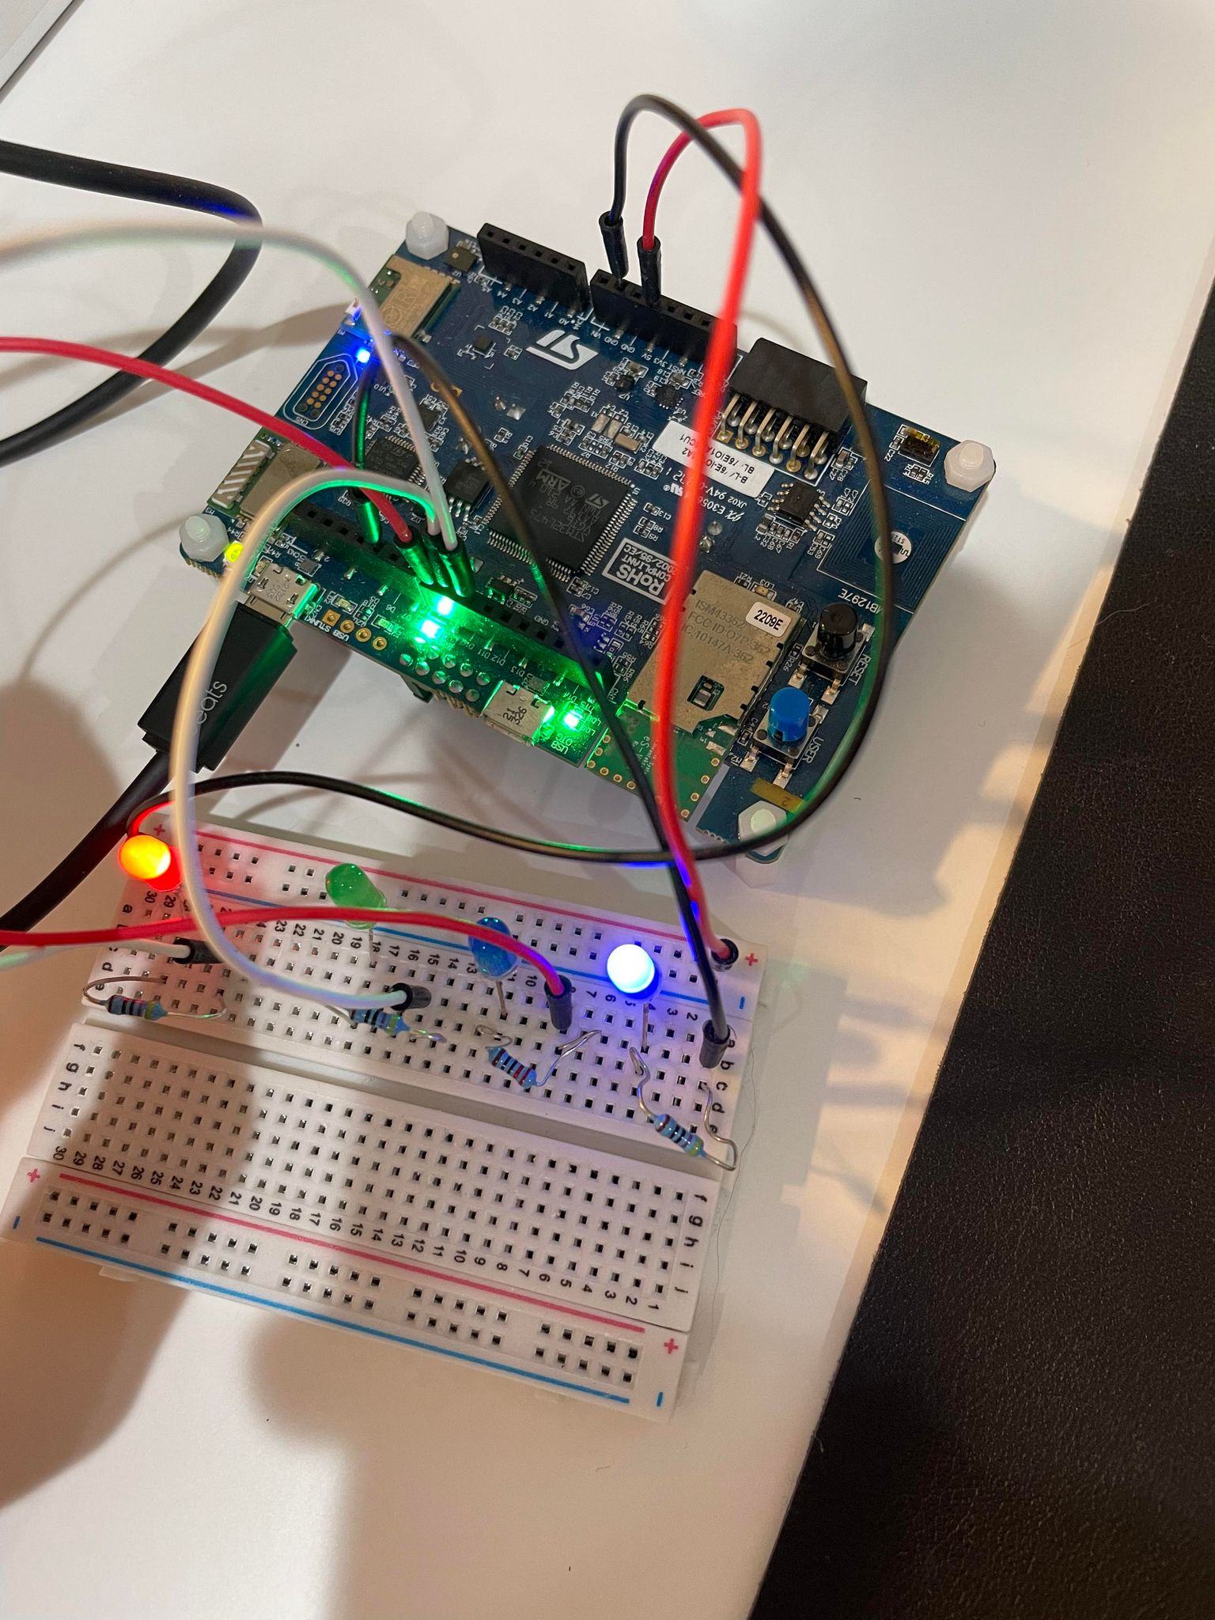
Step 17. Feature 1 test successful, LED2 pin flash at a rate of 2 seconds

Slide 20
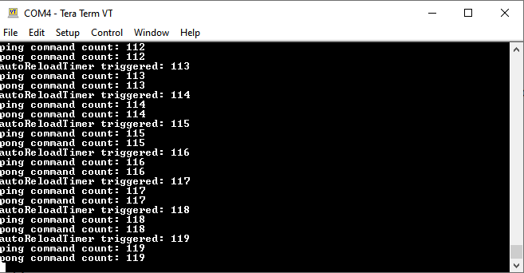
Step 18. Feature 2 test successful, ARD_D5 LED flash at a rate of 2 seconds, timer call back function triggered

Slide 21
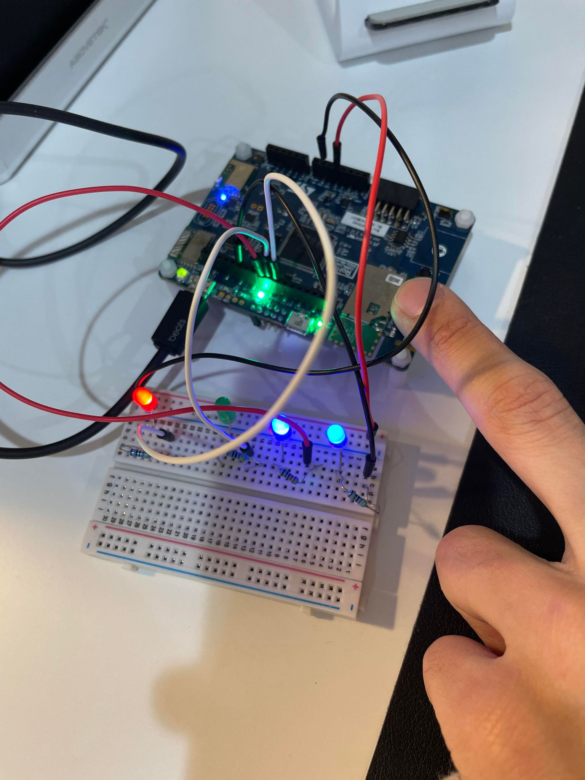
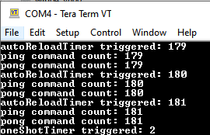
Step 19. one shot timer test successful, call back function triggered, ARD_D8 LED flash with time out 2 seconds

Slide 22
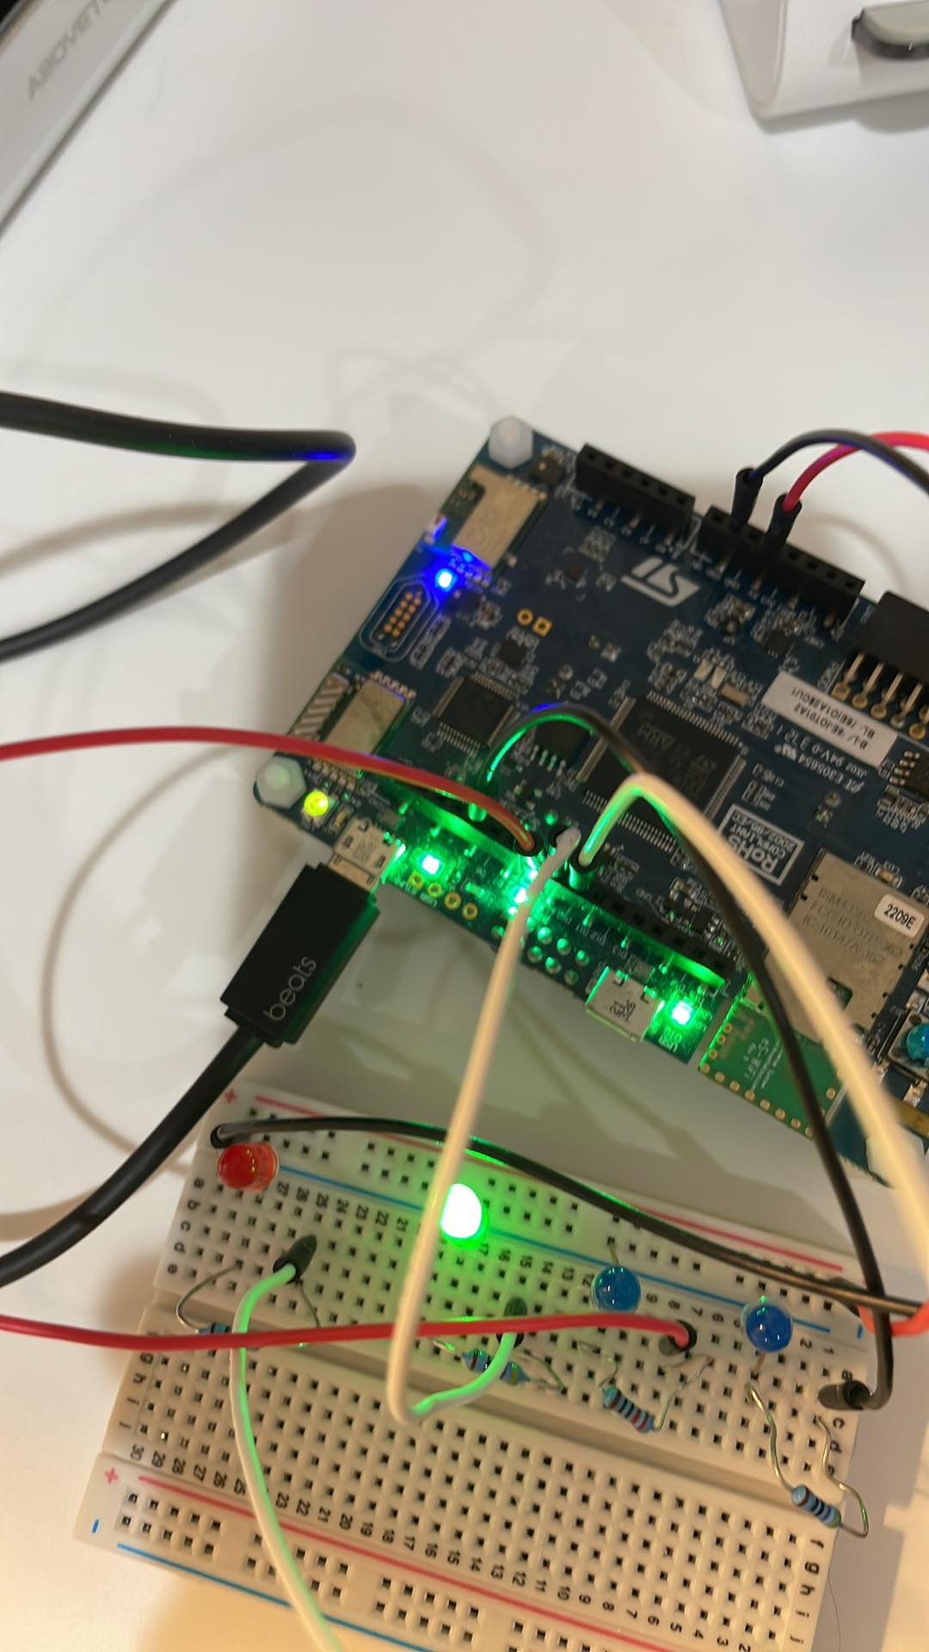
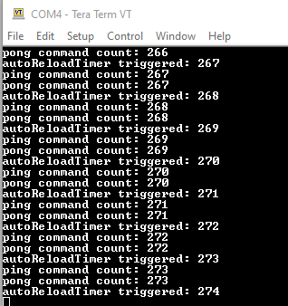
Step 20. Feature 4 test successful, ping pong task send command to queue to toggle LED (ARD_D9, ARD_D10 pin)

Slide 23
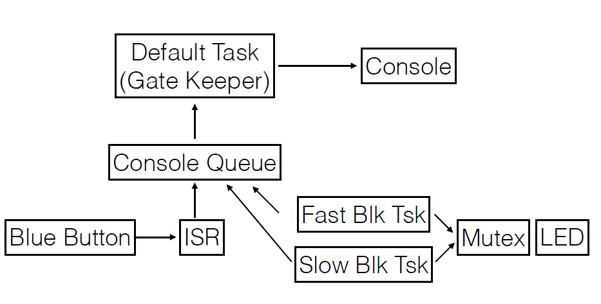
Step 20. Resource LED bonus project. I will create a new project and follow the code demo like below

Slide 24
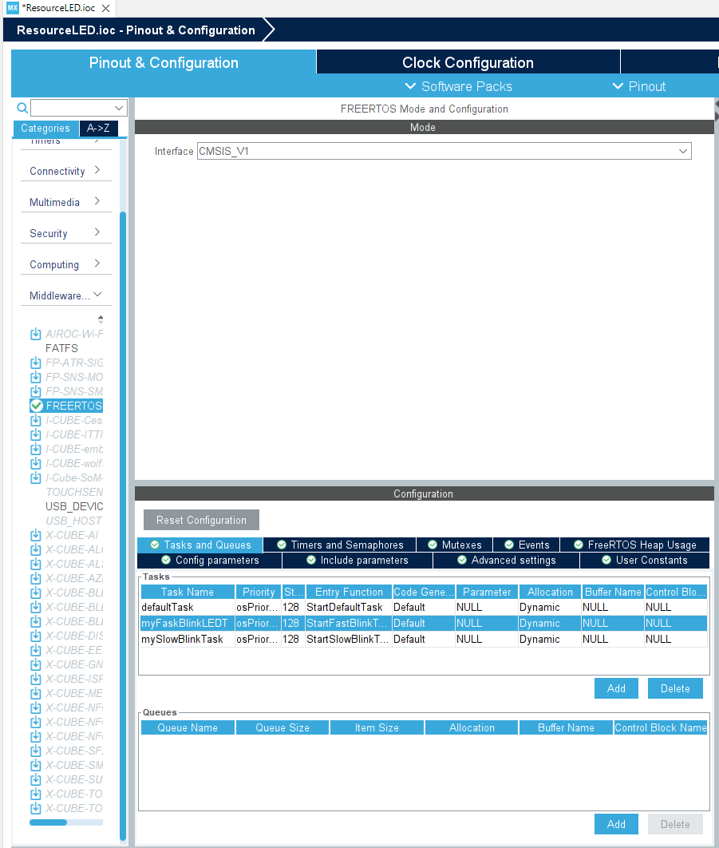
Step 21. Add two more tasks, fast and slow blink tasks

Slide 25
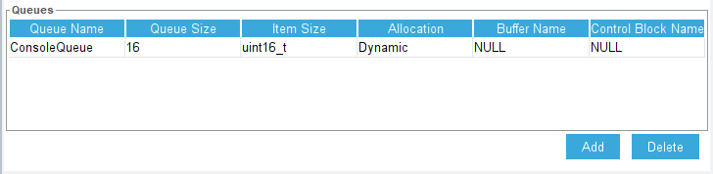
Step 22. Add a queue

Slide 26
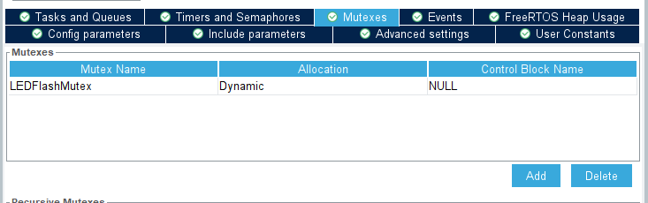
Step 23. Add a mutex

Slide 27
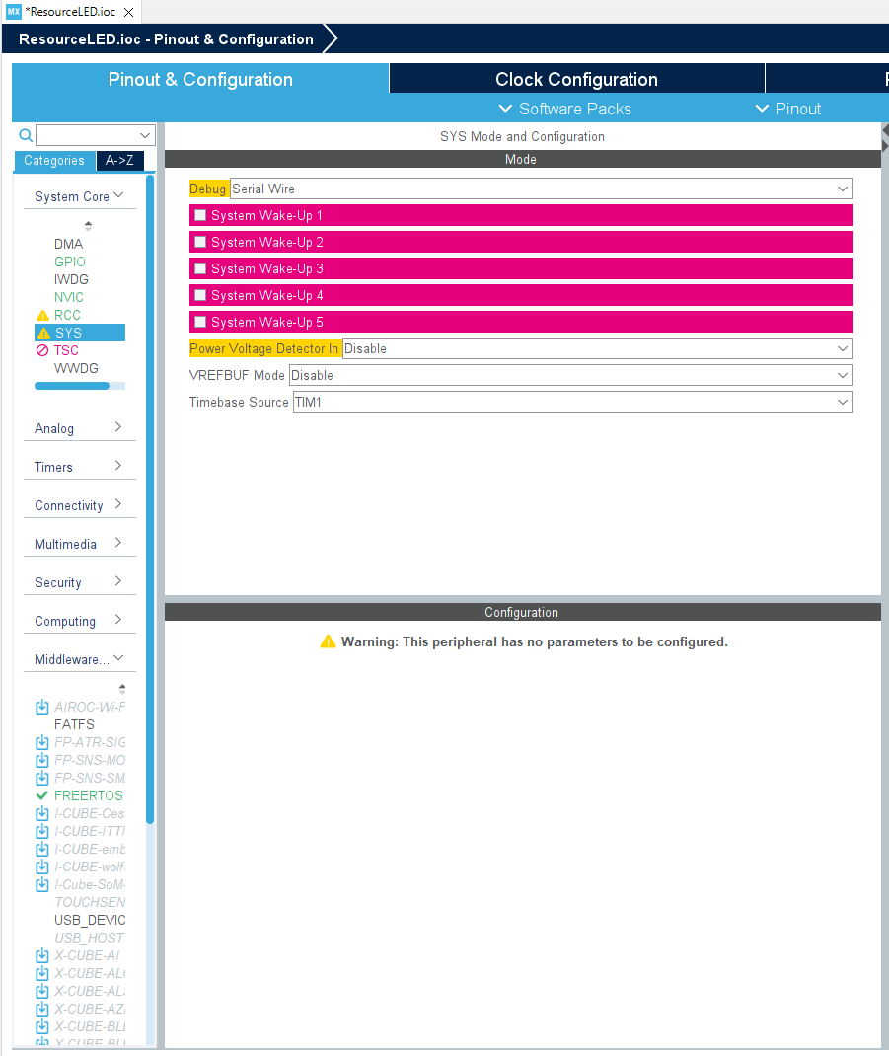
Step 24. Select Timbase to TIM1

Slide 28
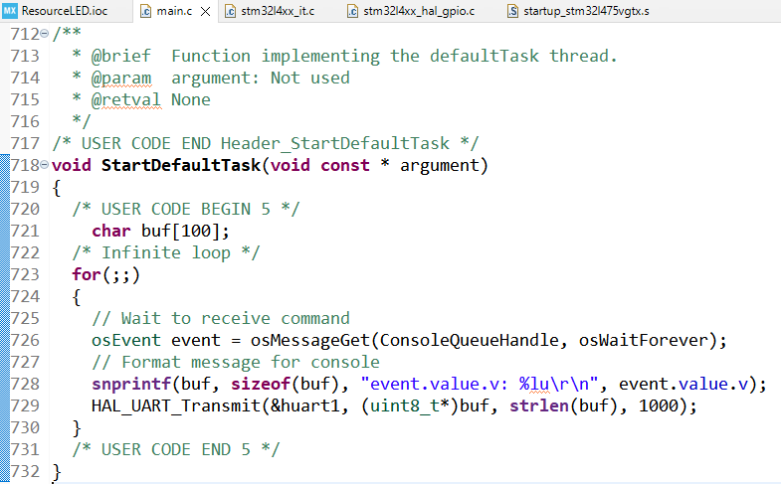
Step 25. Code the default task

Slide 29
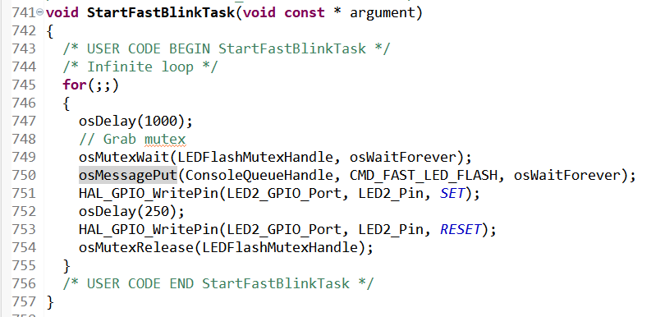
Step 26. Fast LED blink task

Slide 30
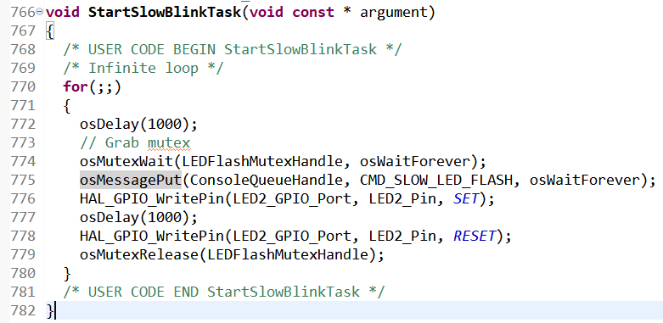
Step 27. slow LED blink test

Slide 31
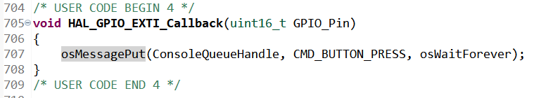
Step 28. GPIO call back

Slide 32
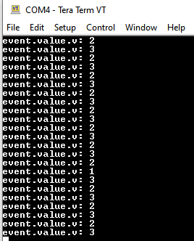
Step 29. Build and run the code, test is successful

Slide 33
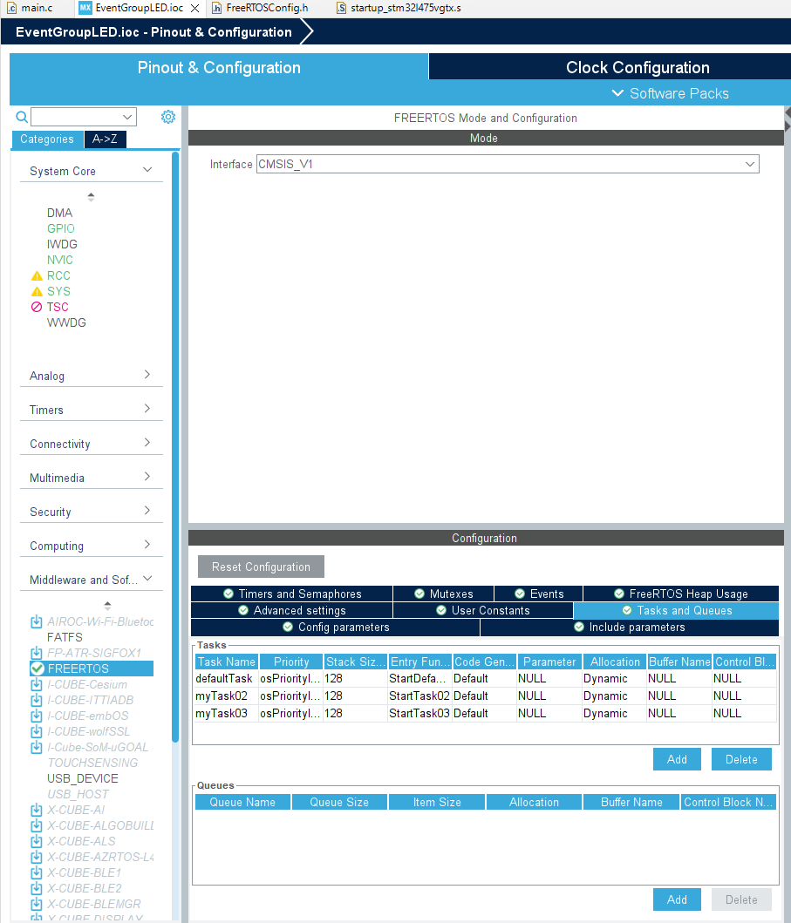
Step 30. Bonus 2, Event group LED project, create 2 more tasks

Slide 34
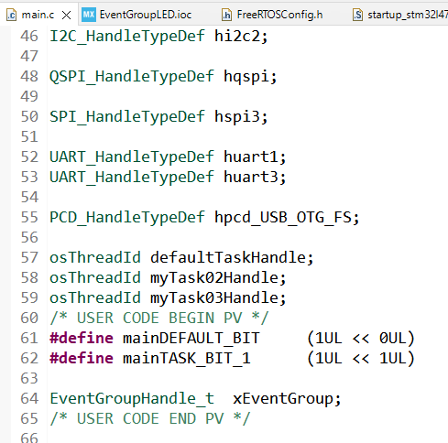
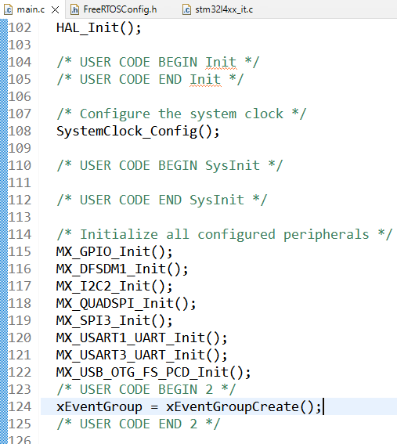
Step 31. Create even group handle and flags

Slide 35
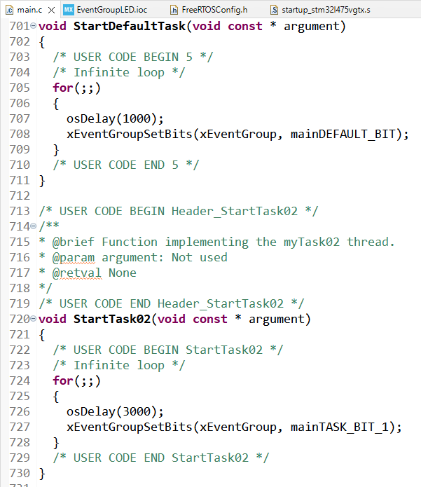
Step 32. Set flags in default task and task02

Slide 36
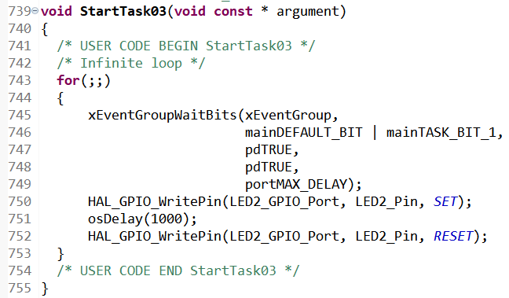
Step 33. Blink LED2 in task3, build and run the code, test is successful

